Slide 1

R Shiny Workshop
Christina Maimone
christina.maimone@northwestern.edu

Slide 2
Handouts
Workshop Information
Shiny cheat sheet
Files - see options on handout
Open RStudio (desktop or cloud)
Get Ready

Slide 3
Christina Maimone
Northwestern University
Research Computing Services
http://www.it.northwestern.edu/research/

Slide 4

Introductions
Say hello to your neighbors

Slide 5
What is Shiny?

Slide 6
An R Package
for creating interactive
web applications
without needing to know
HTML, CSS, or JavaScript

Slide 7
An R Package
for creating interactive
web applications
without needing to know
HTML, CSS, or JavaScript

Slide 8
An R Package
for creating interactive
web applications
without needing to know
HTML, CSS, or JavaScript
Notes:
There are other ways to make web pages with R, even with some limited interactivity -- this lets you take any inputs, run R code, and use R to produce output.
There are other options out there -- but if you're an R user, it's a good option. Always happy to talk about use cases before you start in on a project.

Slide 9
Why use Shiny?

Slide 10
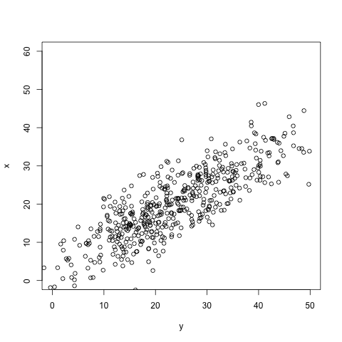
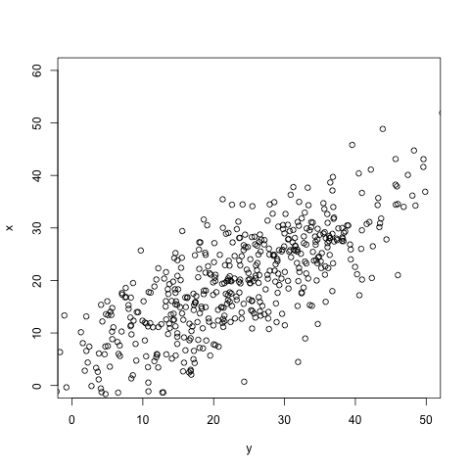
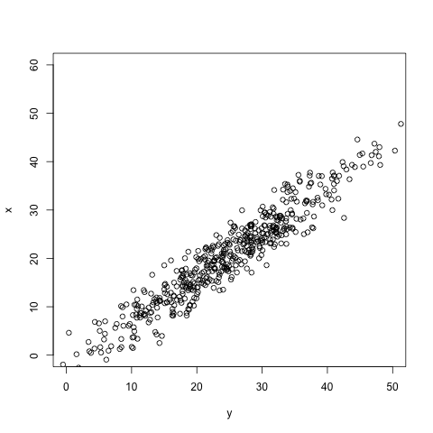
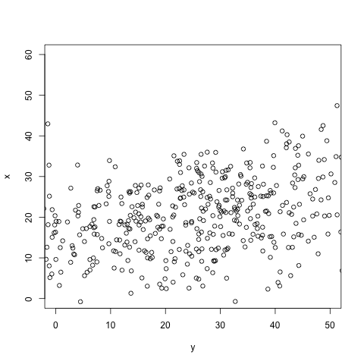
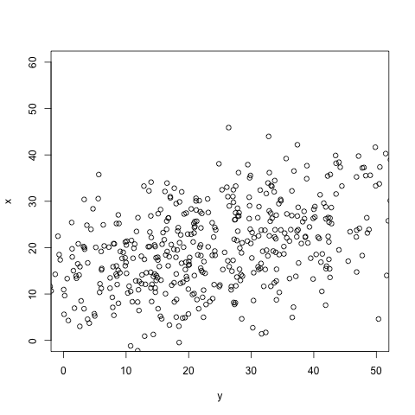
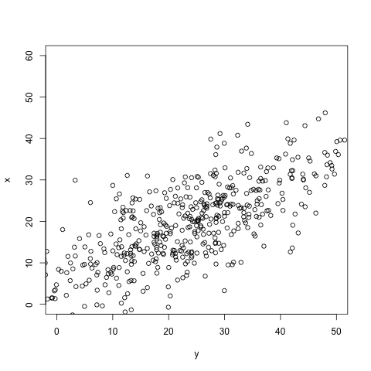
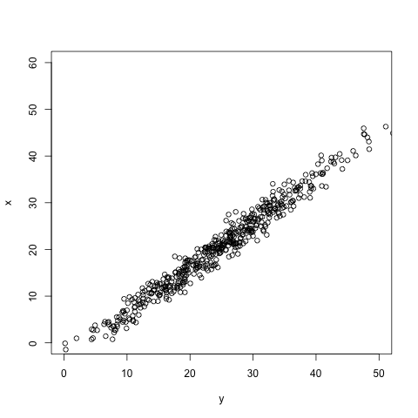
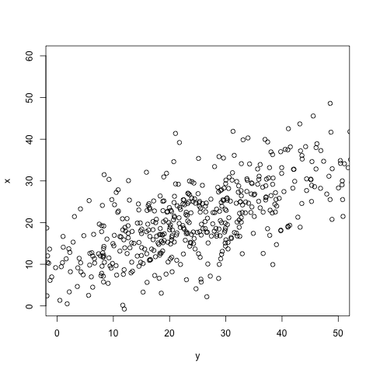
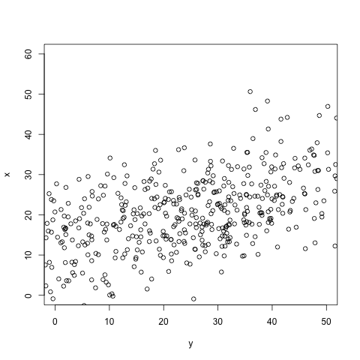
Exploratory Data Analysis

Slide 11
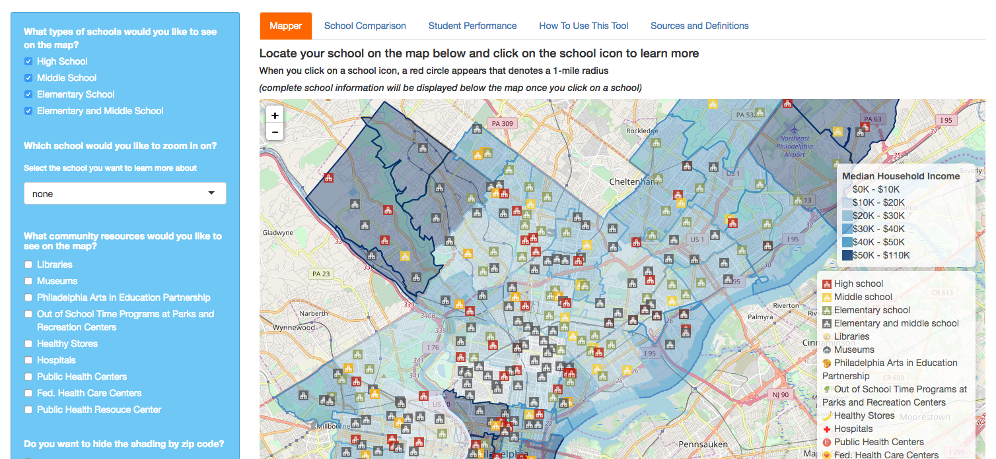
Contextual Learning and Exploration
https://datasociety.com/kitamba-the-opportunity-project/

Slide 12
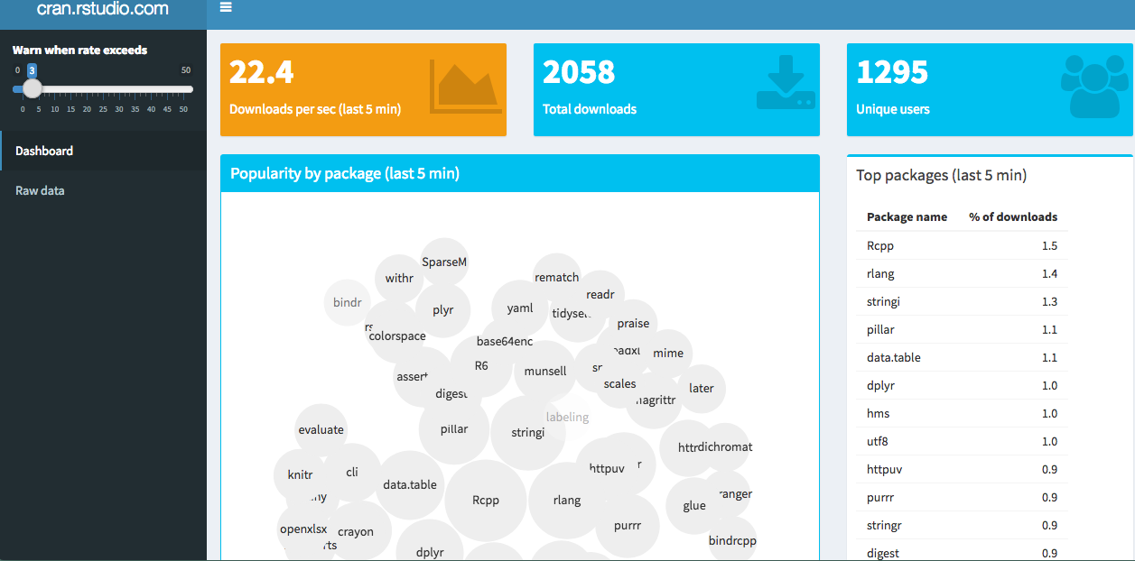
Dashboards
https://gallery.shinyapps.io/087-crandash/
Notes:
Dashboards can be used to monitor ongoing studies.

Slide 13
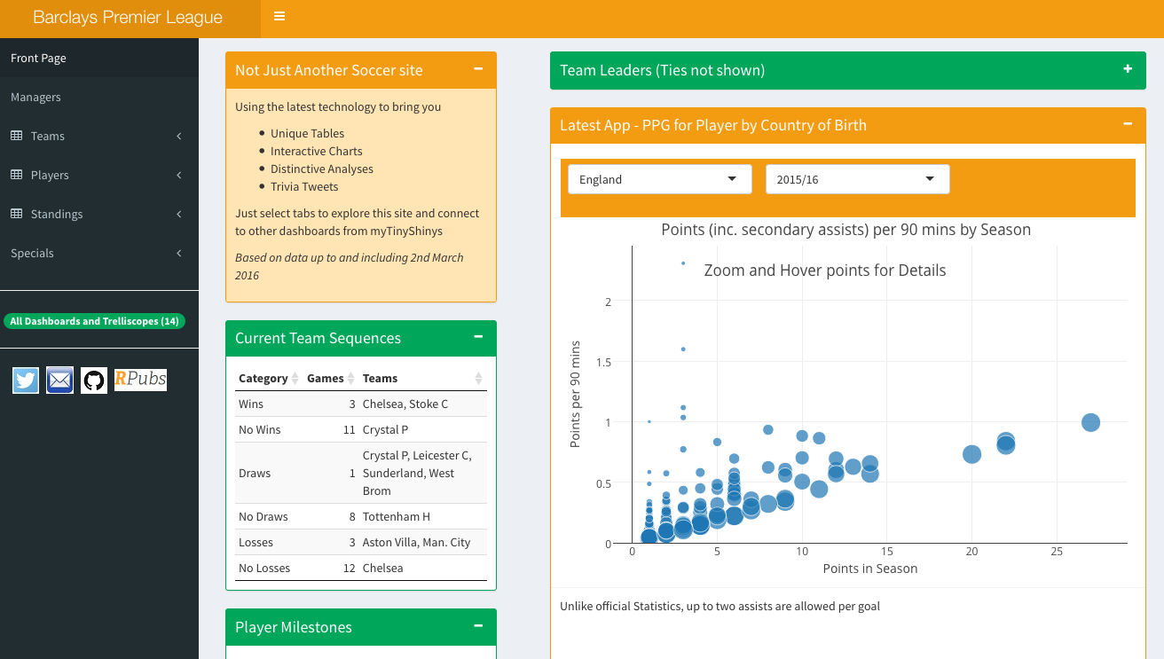
Data, Text, and Visualizations Together
https://gallery.shinyapps.io/premierLeague/

Slide 14
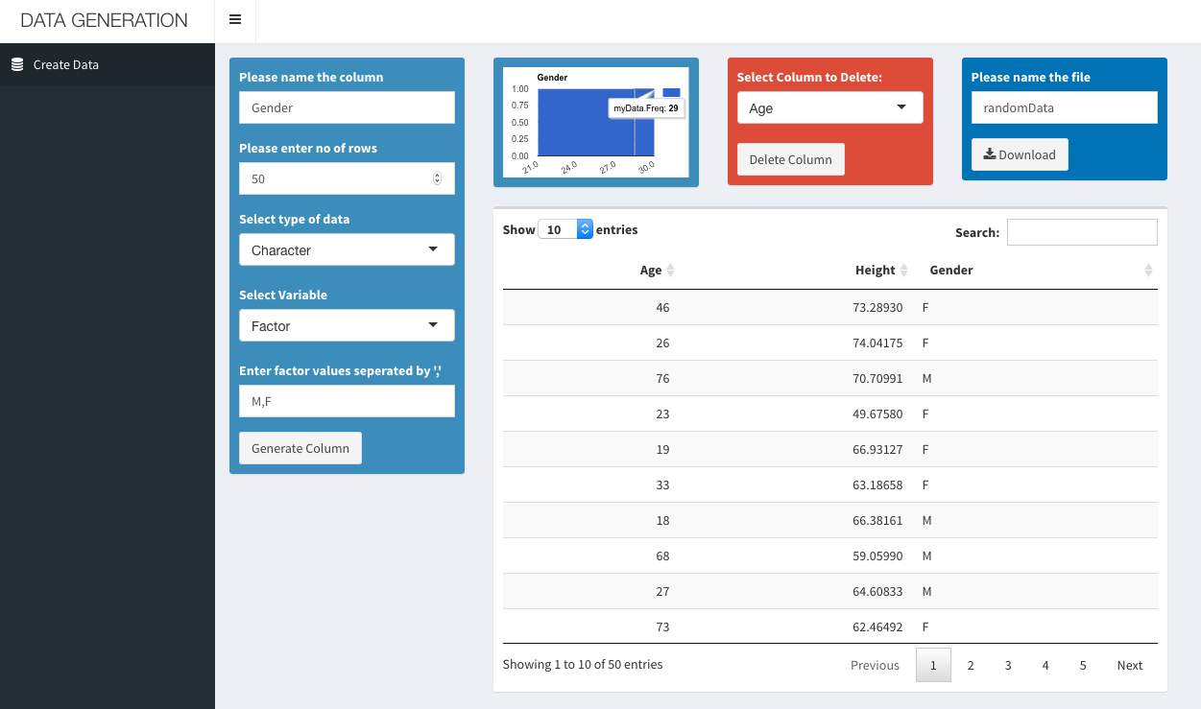
Tools for Your Colleagues or Practitioners
https://ebsubudhi.shinyapps.io/DataGeneration/

Slide 15
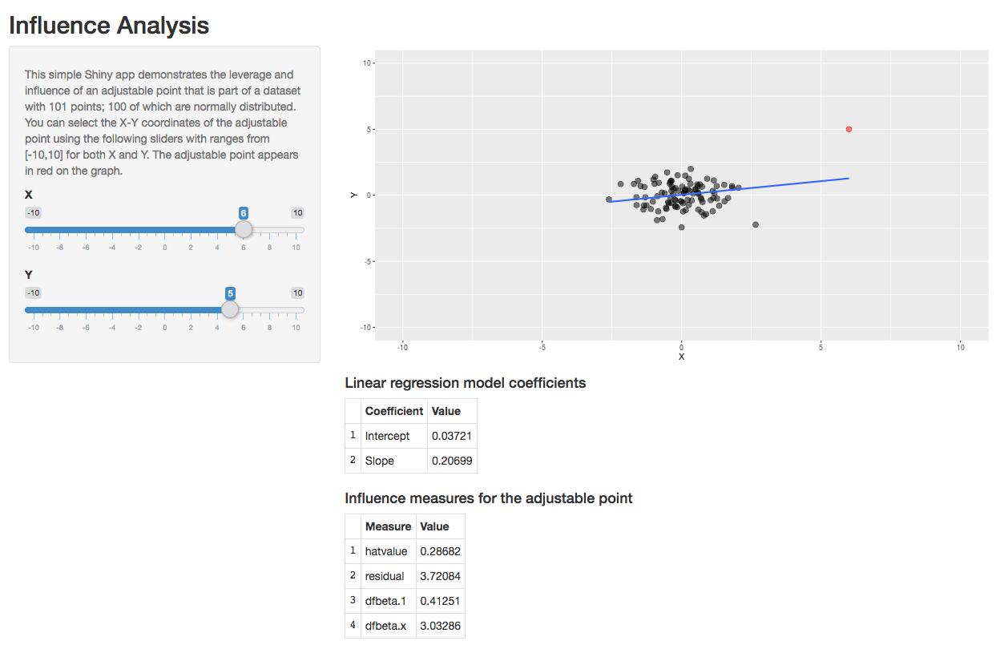
Teaching
https://omaymas.shinyapps.io/Influence_Analysis/

Slide 16
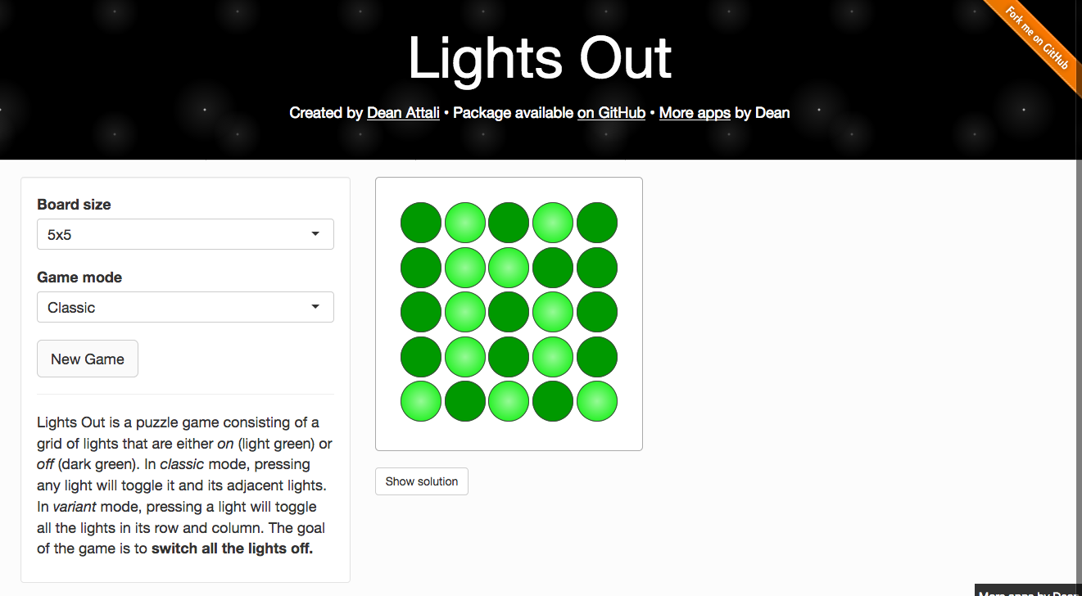
Fun
https://daattali.com/shiny/lightsout/

Slide 17
Demo
examples/120-goog-index/app.R

Slide 18
Structure of Shiny Applications
UI: Layout, Inputs and Outputs
Server
Bringing it Together
Design Elements
Interactive Graphics
Sharing Your Shiny Application

Slide 19

Exercise 1A
Create a new Shiny app
File > New File > Shiny web app
Application Type: Single file
Name: exercise1
Run App
BONUS
Change the x axis label and title on the plot in hist()
xlab="Minutes between Eruptions"
main="Waiting Time Distribution"

Slide 20
Shiny Application Structure
library(shiny)
ui <- fluidPage()
server <- function(input, output) {}
shinyApp(ui = ui, server = server)
Notes:
The above code is a complete — albeit blank - shiny application.

Slide 21
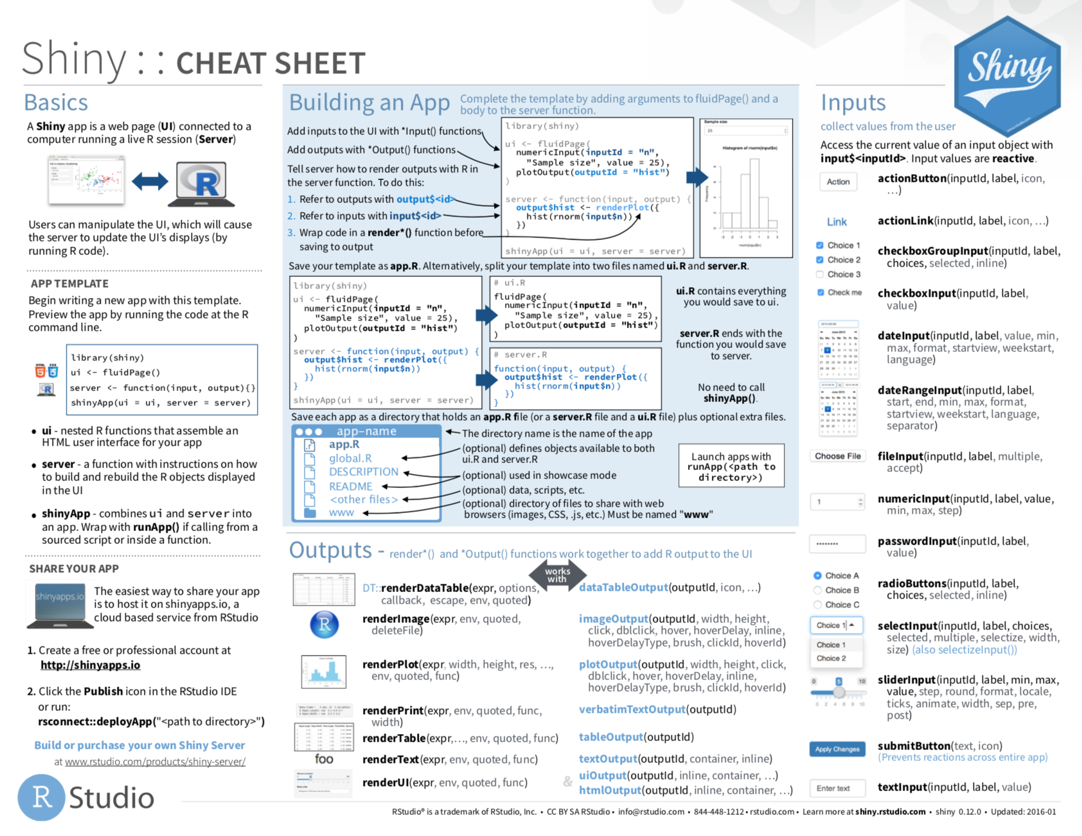

Slide 22
Shiny Application Structure
library(shiny)
ui <- fluidPage()
server <- function(input, output) {}
shinyApp(ui = ui, server = server)
Notes:
First, we need to load the shiny package so the functions we need are available.

Slide 23
Shiny Application Structure
library(shiny)
ui <- fluidPage()
server <- function(input, output) {}
shinyApp(ui = ui, server = server)
Notes:
Then we create the first of the two components that make up our application — the UI or user interface. The fluidPage function takes input, output, and layout functions as arguments.
This is where we define what the application looks like.
Appearance, style, layout, and the set of elements on the page are defined here.

Slide 24
Shiny Application Structure
library(shiny)
ui <- fluidPage()
server <- function(input, output) {}
shinyApp(ui = ui, server = server)
Notes:
The second element we need for our application is a server. The server is a function that takes input and output objects — lists — as arguments. Inside the statement we’ll put a series of R statements that define what the application does.
This is like any other R function, so we can have it do many things inside.
Many commands will be render functions that fill in blocks of the UI with plots, text, data tables, and other elements.

Slide 25
Shiny Application Structure
library(shiny)
ui <- fluidPage()
server <- function(input, output) {}
shinyApp(ui = ui, server = server)
Notes:
Finally, we make a shinyApp by calling the shiny app function and passing the ui and server objects we created above. When you call this function, it creates an application object that later gets run.

Slide 26

Shiny Application Structure
library(shiny)
ui <- fluidPage()
server <- function(input, output) {}
shinyApp(ui = ui, server = server)
app.R
Notes:
We’re going to save the shiny code into a file with the name app.R — this is the name Shiny expects. There’s also an option to divide the code into ui.R and server.R files — this was what you did in earlier versions of Shiny.
One Shiny application per directory (folder). Shiny apps should be isolated in a directory.

Slide 27
runApp('file_directory/')
starts shinyApp
Notes:
When we run the app, it starts a server running and opens the UI — the web page — to display. The server is a process that runs on your computer. It listens for signals from the web browser (or the app window in RStudio) and responds to the signals that are sent from the inputs by running the code in the server function. Then it sends the output back to the ui.
Calling runApp looks for an app.r or server.r file in the directory specified. If you generate this command by clicking on the run app button in Rstudio, it will fill in the path to the file for you.
You don’t include runApp in the .r file itself where you write the Shiny code.

Slide 28

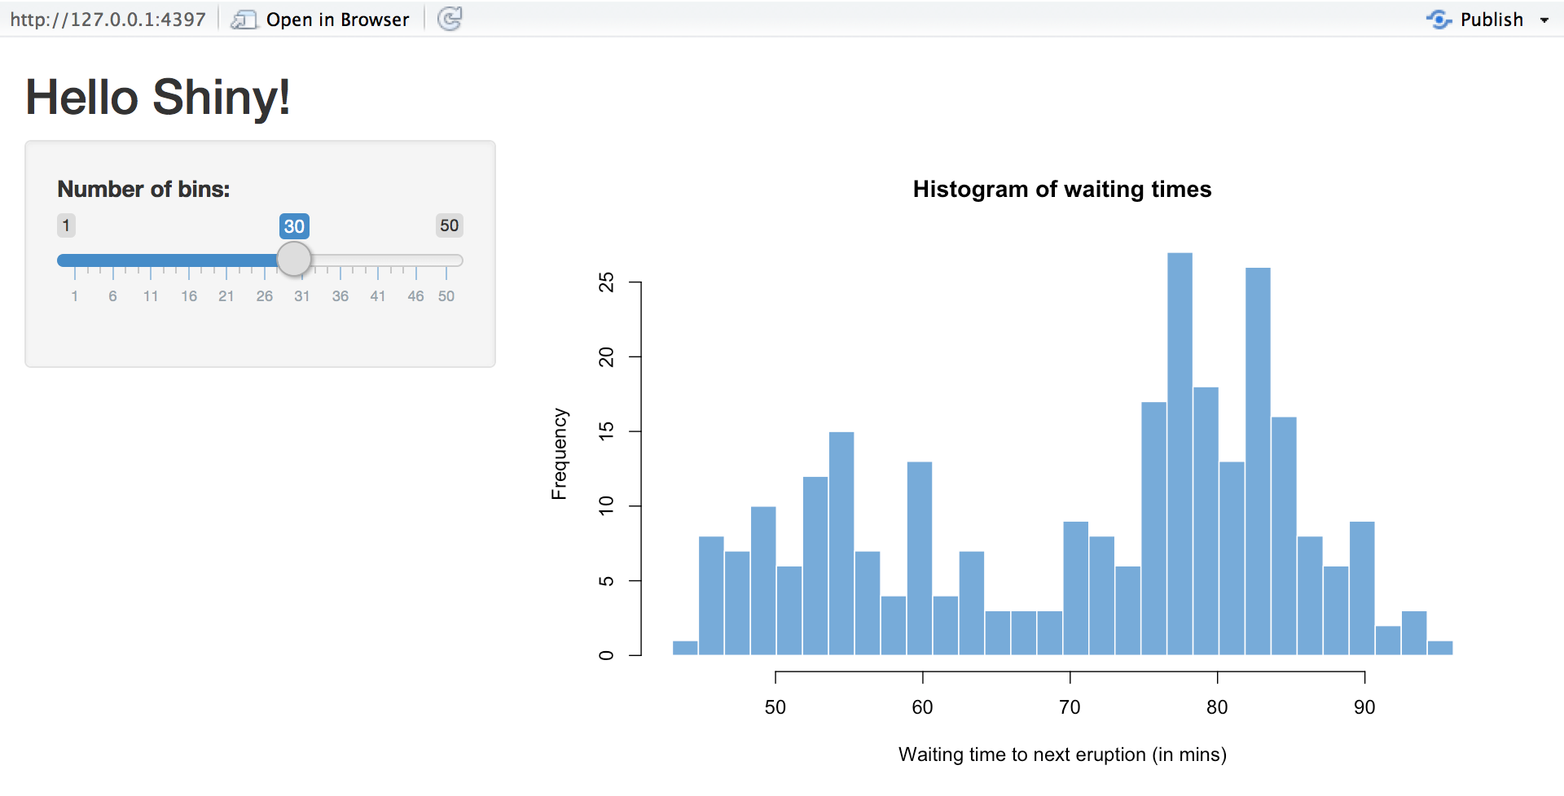

Locally Running Application
Listening on http://127.0.0.1:5859
Notes:
Server is on your computer - application only open to your computer by default
Port number is random within limits

Slide 29

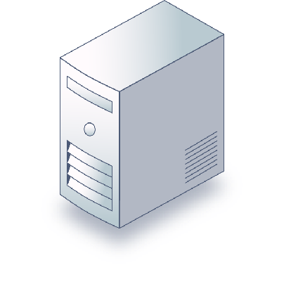
Application Server

Slide 30
Structure of Shiny Applications
UI: Layout, Inputs and Outputs
Server
Bringing it Together
Design Elements
Interactive Graphics
Sharing Your Shiny Application

Slide 31
UI: Layout

Slide 32
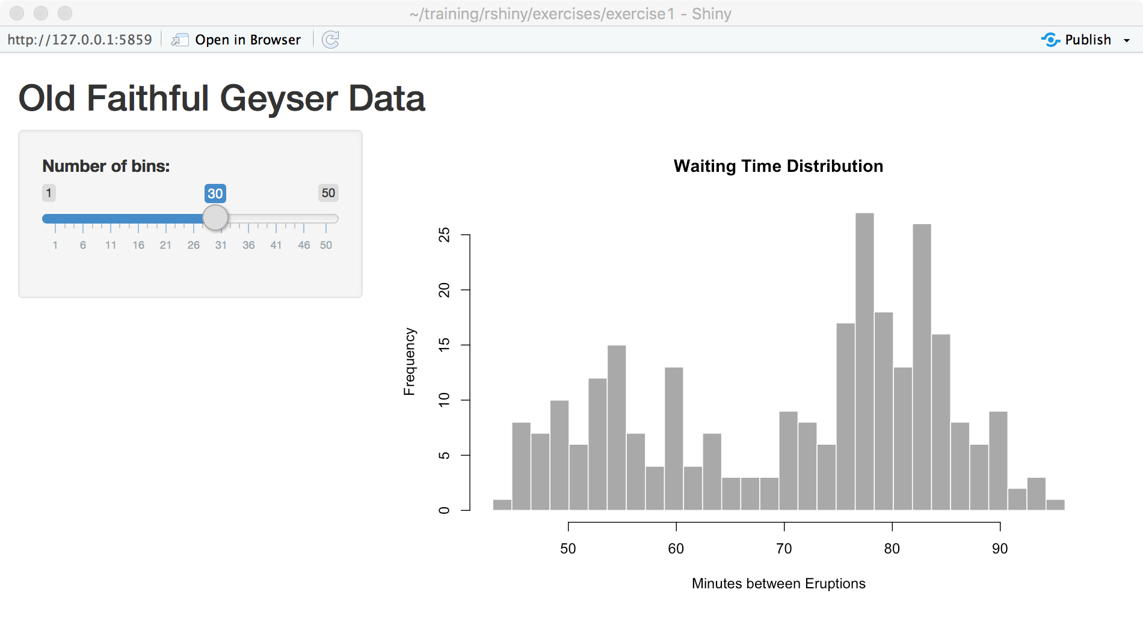

Slide 33
ui <- fluidPage(
titlePanel("Old Faithful Geyser Data"),
sidebarLayout(
sidebarPanel(
sliderInput("bins",
"Number of bins:",
min = 1,
max = 50,
value = 30)
),
mainPanel(
plotOutput("distPlot")
)
)
)

Slide 34
ui <- fluidPage(
titlePanel("Old Faithful Geyser Data"),
sidebarLayout(
sidebarPanel(
sliderInput("bins",
"Number of bins:",
min = 1,
max = 50,
value = 30)
),
mainPanel(
plotOutput("distPlot")
)
)
)

Slide 35
ui <- fluidPage(
titlePanel("Old Faithful Geyser Data"),
sidebarLayout(
sidebarPanel(
sliderInput("bins",
"Number of bins:",
min = 1,
max = 50,
value = 30)
),
mainPanel(
plotOutput("distPlot")
)
)
)

Slide 36
ui <- fluidPage(
titlePanel("Old Faithful Geyser Data"),
sidebarLayout(
sidebarPanel(
sliderInput("bins",
"Number of bins:",
min = 1,
max = 50,
value = 30)
),
mainPanel(
plotOutput("distPlot")
)
)
)

Slide 37
ui <- fluidPage(
titlePanel("Old Faithful Geyser Data"),
sidebarLayout(
sidebarPanel(
sliderInput("bins",
"Number of bins:",
min = 1,
max = 50,
value = 30)
),
mainPanel(
plotOutput("distPlot")
)
)
)
Notes:
Within the sidebar layout, we put two panels — a sidebar panel and main panel

Slide 38
ui <- fluidPage(
titlePanel("Old Faithful Geyser Data"),
sidebarLayout(
sidebarPanel(
sliderInput("bins",
"Number of bins:",
min = 1,
max = 50,
value = 30)
),
mainPanel(
plotOutput("distPlot")
)
)
)
Notes:
Nesting panels and layouts

Slide 39
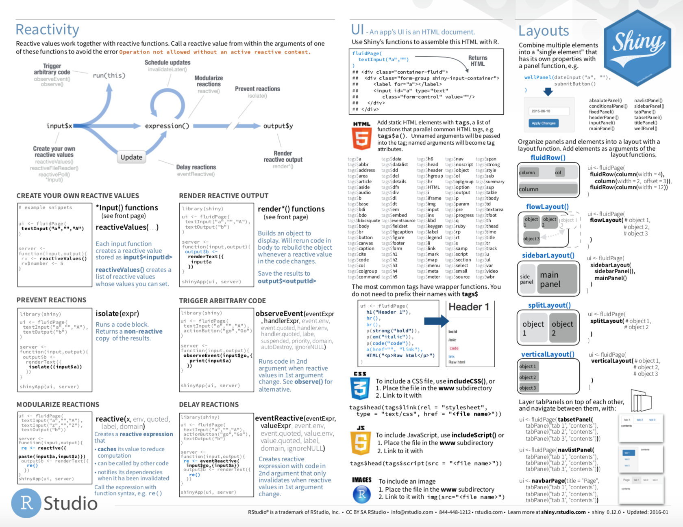

Slide 40
Exercise 1B
Using the app you created in the first exercise :
1. Change the sidebarLayout to verticalLayout
> Run app to see changes
2. Change the sidebarPanel to wellPanel
> Run/Reload app to see changes
3. Between the wellPanel and the mainPanel,
insert a headerPanel("The Plot"). Remember the comma.
> Run/Reload app to see changes

Slide 41
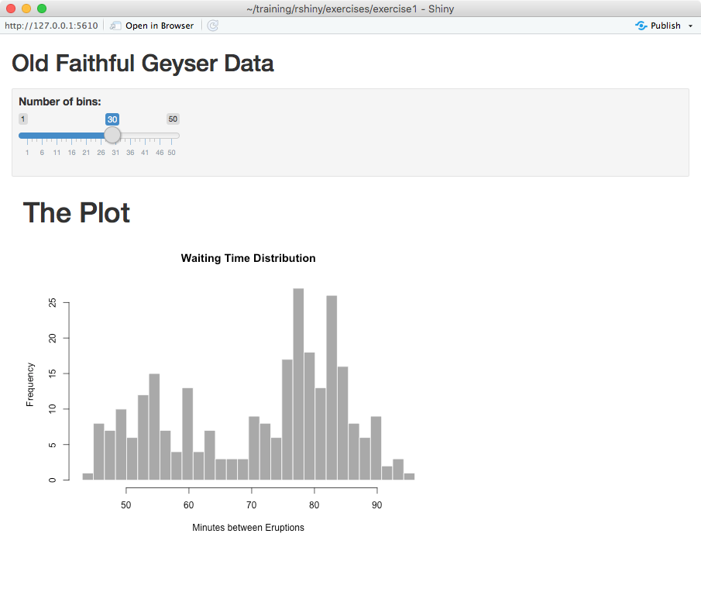

Slide 42
verticalLayout(
wellPanel(
sliderInput("bins",
"Number of bins:",
min = 1,
max = 50,
value = 30)
),
headerPanel("The Plot"),
mainPanel(
plotOutput("distPlot")
)
)

Slide 43
UI: Inputs and Outputs

Slide 44
ui <- fluidPage(
titlePanel("Old Faithful Geyser Data"),
sidebarLayout(
sidebarPanel(
sliderInput("bins",
"Number of bins:",
min = 1,
max = 50,
value = 30)
),
mainPanel(
plotOutput("distPlot")
)
)
)
Name of the input: inputId

Slide 46
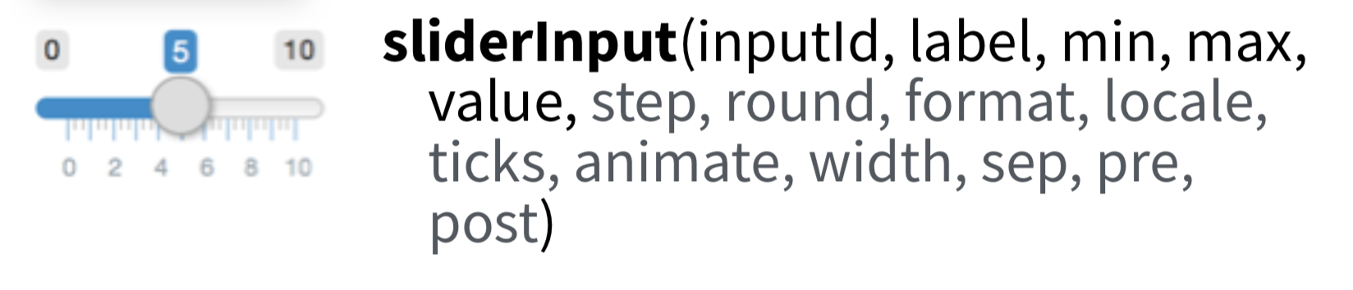
sliderInput("bins",
"Number of bins:",
min = 1,
max = 50,
value = 30)

Slide 47
sliderInput(inputId = “bins",
label = “Number of bins:",
min = 1,
max = 50,
value = 30)

Slide 48
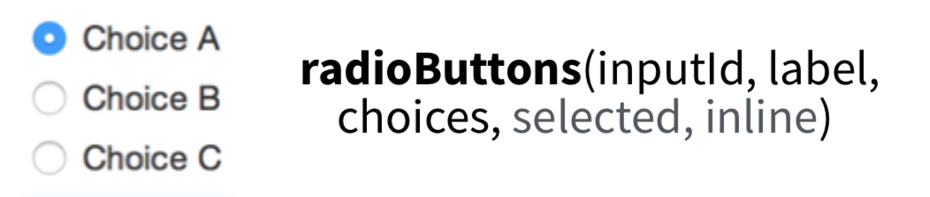
radioButtons(inputId = "choices",
label = "Choose One:",
choices=c("Choice A",
"Choice B",
"Choice C")
)

Slide 49
inputId
is how you get the value
of the input later
inputId="bins" input$bins

Slide 50
ui <- fluidPage(
titlePanel("Old Faithful Geyser Data"),
sidebarLayout(
sidebarPanel(
sliderInput("bins",
"Number of bins:",
min = 1,
max = 50,
value = 30)
),
mainPanel(
plotOutput("distPlot")
)
)
)
Name of the output: outputId
Notes:
The plotOutput line is responsible for putting the plot into the main panel, but the code that creates the plot is in the server function.

Slide 52
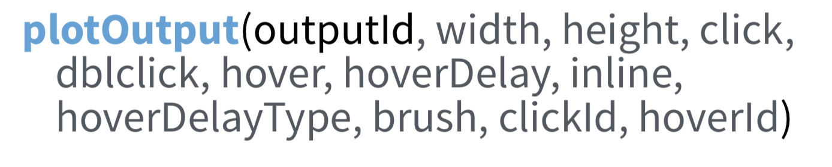
plotOutput("distPlot")

Slide 53
plotOutput(outputId="distPlot")

Slide 54
outputId
is how you set the value
of the output later
outputId="distPlot" output$distPlot

Slide 55
Shiny makes two list-like objects:
input: all inputs, named by inputIds
output: all outputs, named by outputIds

Slide 56
ui <- fluidPage(
titlePanel("Old Faithful Geyser Data"),
sidebarLayout(
sidebarPanel(
sliderInput("bins",
"Number of bins:",
min = 1,
max = 50,
value = 30)
),
mainPanel(
plotOutput("distPlot")
)
)
)
Notes:
Pause for questions

Slide 57

Exercise 1C
Create a new Shiny app, as you did in Exercise 1A, or work from the previous file
To the sidebarPanel (or inputPanel if you changed it last exercise), add a radioButtons input after the sliderInput with
inputId="color"
label="Bar Color"
choices=c("red","blue","green")
Run the app to make sure there aren't any errors. Note: the radio input won't have an effect yet.

Slide 58
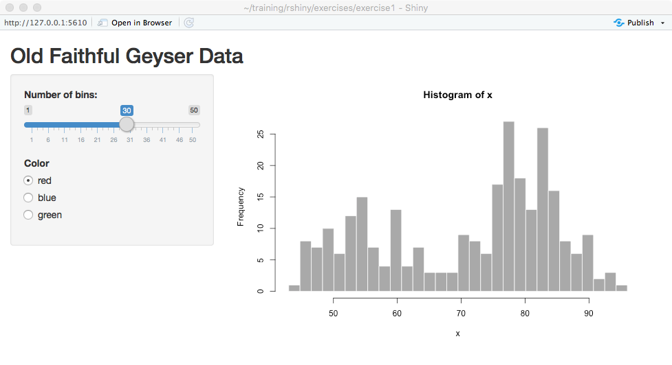

Slide 59
sidebarPanel(
sliderInput("bins",
"Number of bins:",
min = 1,
max = 50,
value = 30),
radioButtons(inputId="color",
label="Color",
choices=c("red","blue","green"))
),

Slide 60
Structure of Shiny Applications
UI: Layout, Inputs and Outputs
Server
Bringing it Together
Design Elements
Interactive Graphics
Sharing Your Shiny Application

Slide 61
Shiny supplies
these from the UI
server <- function(input, output) {
output$distPlot <- renderPlot({
x <- faithful[, 2]
bins <- seq(min(x), max(x), length.out = input$bins + 1)
hist(x, breaks = bins, col = 'darkgray',
border = 'white',
xlab="Minutes between Eruptions",
main="Waiting Time Distribution")
})
}

Slide 62
server <- function(input, output) {
output$distPlot <- renderPlot({
x <- faithful[, 2]
bins <- seq(min(x), max(x), length.out = input$bins + 1)
hist(x, breaks = bins, col = 'darkgray',
border = 'white',
xlab="Minutes between Eruptions",
main="Waiting Time Distribution")
})
}
Notes:
The shiny app sends input and output list objects to the server function.
You can get information from the inputs by referencing elements of the input list.
You can change outputs by setting elements of the output list.
The names in the lists correspond to elements in the UI

Slide 63
ui <- fluidPage(
titlePanel("Old Faithful Geyser Data"),
sidebarLayout(
sidebarPanel(
sliderInput("bins", "Number of bins:", min = 1, max = 50, value = 30)
),
mainPanel(
plotOutput("distPlot")
)
)
)
server <- function(input, output) {
output$distPlot <- renderPlot({
x <- faithful[, 2]
bins <- seq(min(x), max(x), length.out = input$bins + 1)
hist(x, breaks = bins, col = 'darkgray', border = 'white',
xlab="Minutes between Eruptions", main="Waiting Time Distribution")
})
}

Slide 64
server <- function(input, output) {
output$distPlot <- renderPlot({
x <- faithful[, 2]
bins <- seq(min(x), max(x), length.out = input$bins + 1)
hist(x, breaks = bins, col = 'darkgray',
border = 'white',
xlab="Minutes between Eruptions",
main="Waiting Time Distribution")
})
}
Notes:
renderPlot creates a reactive plot — meaning a plot that will respond to changes in the inputs

Slide 66
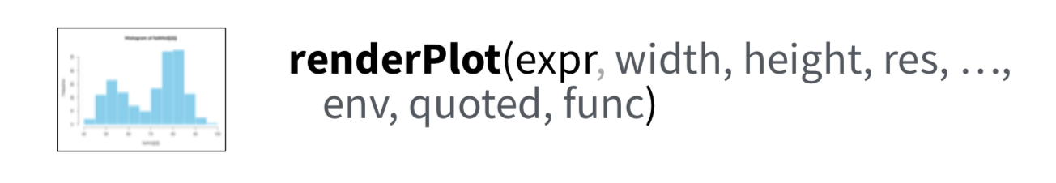
Any R expression
Multiple lines in {}

Slide 67
server <- function(input, output) {
output$distPlot <- renderPlot({
x <- faithful[, 2]
bins <- seq(min(x), max(x), length.out = input$bins + 1)
hist(x, breaks = bins, col = 'darkgray',
border = 'white',
xlab="Minutes between Eruptions",
main="Waiting Time Distribution")
})
}
Notes:
Curly braces define a block of code - inside a block, we can write multiple lines of R code like we would in a function or loop

Slide 68
server <- function(input, output) {
output$distPlot <- renderPlot({
x <- faithful[, 2]
bins <- seq(min(x), max(x), length.out = input$bins + 1)
hist(x, breaks = bins, col = 'darkgray',
border = 'white',
xlab="Minutes between Eruptions",
main="Waiting Time Distribution")
})
}

Slide 69
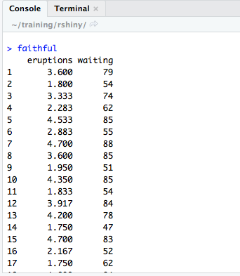

Slide 70
server <- function(input, output) {
output$distPlot <- renderPlot({
x <- faithful[, 2]
bins <- seq(min(x), max(x), length.out = input$bins + 1)
hist(x, breaks = bins, col = 'darkgray',
border = 'white',
xlab="Minutes between Eruptions",
main="Waiting Time Distribution")
})
}

Slide 71
server <- function(input, output) {
output$distPlot <- renderPlot({
x <- faithful[, 2]
bins <- seq(min(x), max(x), length.out = input$bins + 1)
hist(x, breaks = bins, col = 'darkgray',
border = 'white',
xlab="Minutes between Eruptions",
main="Waiting Time Distribution")
})
}

Slide 72
server <- function(input, output) {
output$distPlot <- renderPlot({
x <- faithful[, 2]
bins <- seq(min(x), max(x), length.out = input$bins + 1)
hist(x, breaks = bins, col = 'darkgray',
border = 'white',
xlab="Minutes between Eruptions",
main="Waiting Time Distribution")
})
}
Notes:
The shiny app sends input and output list objects to the server function.
You can get information from the inputs by referencing elements of the input list.
You can change outputs by setting elements of the output list.
The names in the lists correspond to elements in the UI

Slide 73
server <- function(input, output) {
output$distPlot <- renderPlot({
x <- faithful[, 2]
bins <- seq(min(x), max(x), length.out = input$bins + 1)
hist(x, breaks = bins, col = 'darkgray',
border = 'white',
xlab="Minutes between Eruptions",
main="Waiting Time Distribution")
})
}
Notes:
The shiny app sends input and output list objects to the server function.
You can get information from the inputs by referencing elements of the input list.
You can change outputs by setting elements of the output list.
The names in the lists correspond to elements in the UI

Slide 74
ui <- fluidPage(
titlePanel("Old Faithful Geyser Data"),
sidebarLayout(
sidebarPanel(
sliderInput("bins", "Number of bins:", min = 1, max = 50, value = 30)
),
mainPanel(
plotOutput("distPlot")
)
)
)
server <- function(input, output) {
output$distPlot <- renderPlot({
x <- faithful[, 2]
bins <- seq(min(x), max(x), length.out = input$bins + 1)
hist(x, breaks = bins, col = 'darkgray', border = 'white',
xlab="Minutes between Eruptions", main="Waiting Time Distribution")
})
}

Slide 75
Exercise 1D
Using the app you created in Exercise 1C (with the color radioButtons), or exercises/exercise1/answer1c.R:
Set the color (col=) of the bars in the histogram (hist) using the value from the color radioButtons input
BONUS
Change the default color choice to green instead of red using selected= as part of the radioButtons input
Add additional color choices

Slide 76
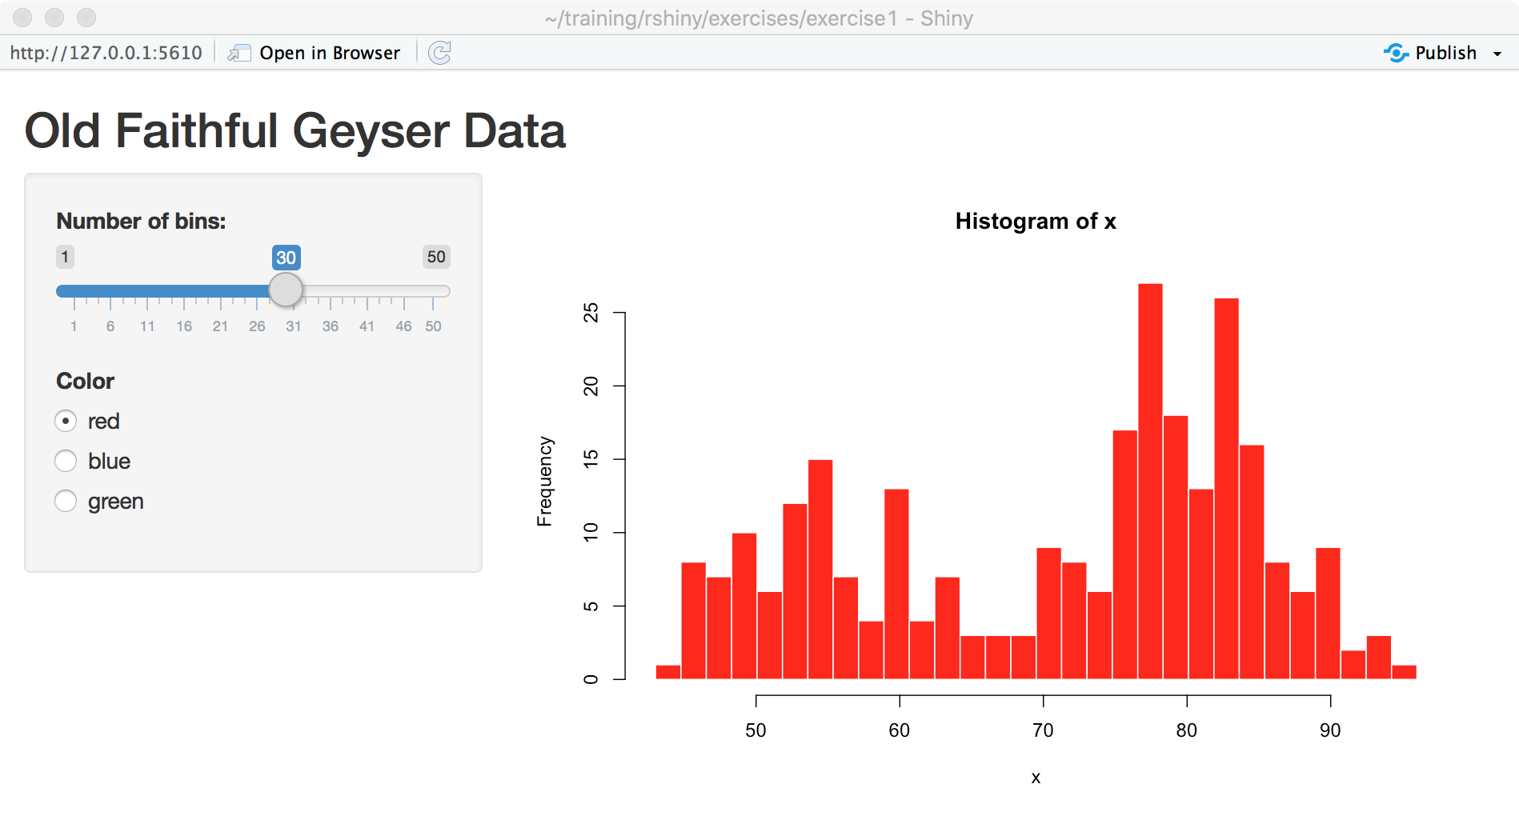

Slide 77
server <- function(input, output) {
output$distPlot <- renderPlot({
# generate bins based on input$bins from ui.R
x <- faithful[, 2]
bins <- seq(min(x), max(x), length.out = input$bins + 1)
# draw the histogram with the specified number of bins
hist(x, breaks = bins, col = input$color, border = 'white')
})
}

Slide 78
Structure of Shiny Applications
UI: Layout, Inputs and Outputs
Server
Bringing it Together
Design Elements
Interactive Graphics
Sharing Your Shiny Application

Slide 79
Debugging

Slide 80
Watch out for formatting errors!
Notes:
There are lots of parentheses and curly braces that need to be matched. Commas between some chunks of code, $ for lists, etc.

Slide 81
Run code
Look at error messages
Try to fix
Run again

Slide 82
Location of the error may be slightly above the line number referenced in the error message

Slide 83

Exercise 2A & B
exercises/exercise2/app.R
A: The code contains 3 errors — try to fix them and get the code to run. Hint: check that names match between UI and server sections (2 errors), look for missing commas (1 error).
B (challenge if time): Fill in the code to render a DataTable of the entire data set.
What is the name of the element on output you need to set? output$_____
Using the cheat sheet, what is the render function for a DataTable that goes with dataTableOutput?
The only expr you need for the render function is the name of the data frame. To find this, look at the top of the file for the line where the csv is imported.
Notes:
Solution:
Select input inputId
Comma
output$plot
shinyApp — ui and server

Slide 84
...
mainPanel(
plotOutput("plot1")
)
),
verticalLayout(
DT::dataTableOutput("datatable1")
)
)
server <- function(input, output) {
output$plot1 <- renderPlot({
ggplot(data, aes_string(x="area", y=input$yval)) +
geom_point() +
geom_smooth(color="red", method="lm") +
xlab("Area (sq km)") +
theme_minimal()
})
output$datatable1 <- DT::renderDataTable(data)
}
shinyApp(ui = ui, server = server)
Notes:
Could have renamed inputId and outputId above instead of changing them here
DT:: — syntax to call a function from a package explicitly — in this case, collisions with shiny package

Slide 85
From above, in UI:
DT::dataTableOutput("datatable1")
output$datatable1 <- DT::renderDataTable(africadata)
From above, after library imports:
africadata <- read_csv("africadata.csv")

Slide 86
Exercise 2

Slide 87
library(shiny)
library(readr)
library(ggplot2)
africadata <- read_csv("africadata.csv")
ui <- fluidPage(
titlePanel("Africa: Country Size"),
sidebarLayout(
sidebarPanel(
selectInput(inputId = "yval",
label = "Y-axis:",
choices = c("GDP" = "gdp_2017", "Population" = "pop_2017",
"Railroads" = "rail", "Roads" = "road"),
selected = "gdp_2017")
),
mainPanel(
plotOutput("plot1")
)
),
verticalLayout(
DT::dataTableOutput("datatable1")
)
)

Slide 88
library(shiny)
library(readr)
library(ggplot2)
data <- read_csv("africadata.csv")
ui <- fluidPage(
titlePanel("Africa: Country Size"),
sidebarLayout(
sidebarPanel(
selectInput(inputId = "yval",
label = "Y-axis:",
choices = c("GDP" = "gdp_2017", "Population" = "pop_2017",
"Railroads" = "rail", "Roads" = "road"),
selected = "gdp_2017")
),
mainPanel(
plotOutput("plot1")
)
),
verticalLayout(
DT::dataTableOutput("datatable1")
)
)
input$yval
output$plot1
output$datatable1
Notes:
choices are named: labels that appear vs. values that are saved in input$yval

Slide 89
server <- function(input, output) {
output$plot1 <- renderPlot({
ggplot(africadata, aes_string(x="area", y=input$yval)) +
geom_point() +
geom_smooth(color="red", method="lm") +
xlab("Area (sq km)") +
theme_minimal()
})
output$datatable1 <- DT::renderDataTable(africadata)
}

Slide 90
Applications and Sessions

Slide 91
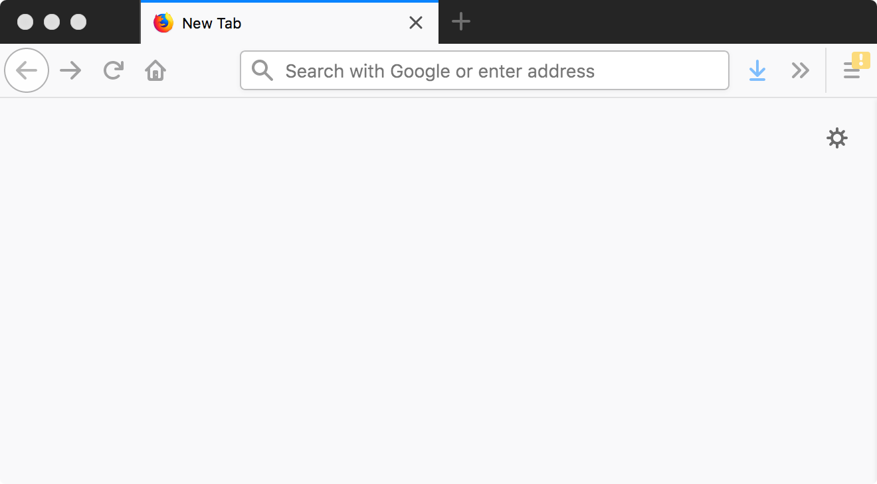
Application vs. Sessions
Multiple Sessions
Multiple Applications
Shiny Server
Notes:
We've been running the apps on our own computer for ourselves — or if you're using the cloud, you're running an application that only you have access to.
When sharing with other people, your app will be running on a shiny server.
Each server can host multiple applications. For each application, there can be multiple sessions — either different users on different computers, or different web browser windows or tabs from the same user. Some functionality is shared across sessions, and some isn't.

Slide 92
Shiny Application Structure
library(shiny)
ui <- fluidPage()
server <- function(input, output) {}
shinyApp(ui = ui, server = server)
Notes:
Back to our basic template for a moment.
What code gets called when?

Slide 93
Shiny Application Structure
Called once when
application starts
library(shiny)
ui <- fluidPage()
server <- function(input, output) {}
shinyApp(ui = ui, server = server)
Notes:
Code not part of the ui or server gets called once when the application starts. In our template, that's the library loading call and the shinyApp call
There are a few complexities I'm skipping over here, but this code is run once when the application is live and available for people to use — whether that's just you on your laptop or multiple people

Slide 94
Shiny Application Structure
Called once when
a user connects —
once for each session
library(shiny)
ui <- fluidPage()
server <- function(input, output) {}
shinyApp(ui = ui, server = server)
Notes:
When someone opens up a session of the application — so a tab in a browser — the ui and server functions are called once. The code in these is executed.

Slide 95
Shiny Application Structure
Chunks of code
inside server function
can be called many times
library(shiny)
ui <- fluidPage()
server <- function(input, output) {…}
shinyApp(ui = ui, server = server)
Notes:
As we talked about above, when a session is created for a user, the shiny application knows to listen for changes in inputs and run the appropriate output code in response. So individual chunks of the code inside the server function can get run multiple times. The entire server function isn't run each time — just specific chunks of code.

Slide 96
Shiny Application Structure
library(shiny)
ui <- fluidPage()
server <- function(input, output) {}
shinyApp(ui = ui, server = server)
Add code that should only be called
once per application here
Notes:
Code that you only want called once, like importing a data set or loading packages, should be outside of the server function.
Any objects created here are accessible to the UI and server, but they’re static across sessions/users— they don’t change in response to inputs
Code that can be shared should be shared for efficiency — especially large data sets

Slide 97
Shiny Application Structure
library(shiny)
ui <- fluidPage()
server <- function(input, output) {
}
shinyApp(ui = ui, server = server)
Add code that should only be called
once per session here
output$x <- …
Notes:
If there's setup for a specific session — things that shouldn't be shared but still are just run once — it goes in the server function

Slide 98
Reactivity
input is a reactive source
output is a reactive endpoint
Shiny manages input and output for you
You can
Define other relationships
Create more complicated conditions
Trigger events
Interrupt relationships
Notes:
reactive source can send signals when it updates
reactive endpoints get told when to re-execute; they can request current values of inputs

Slide 99
Structure of Shiny Applications
UI: Layout, Inputs and Outputs
Server
Bringing it Together
Design Elements
Interactive Graphics
Sharing Your Shiny Application

Slide 100
UI Elements with Tags

Slide 101
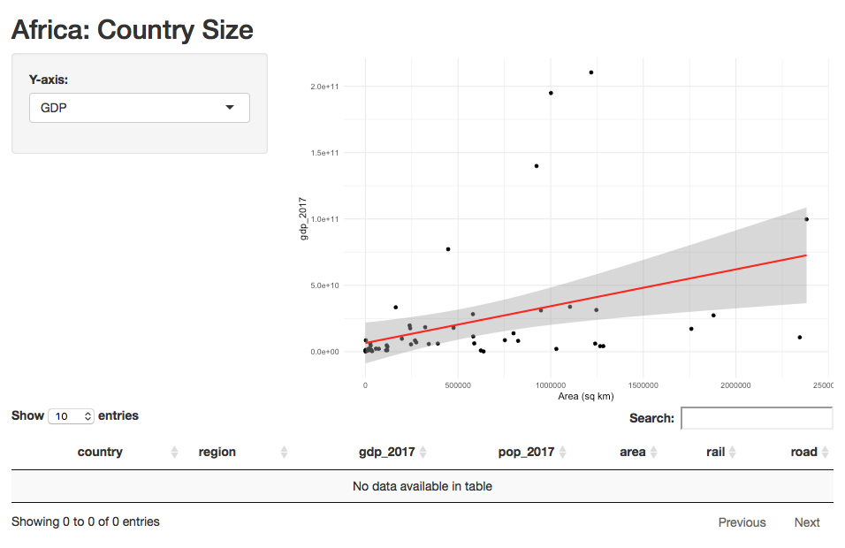

Slide 102
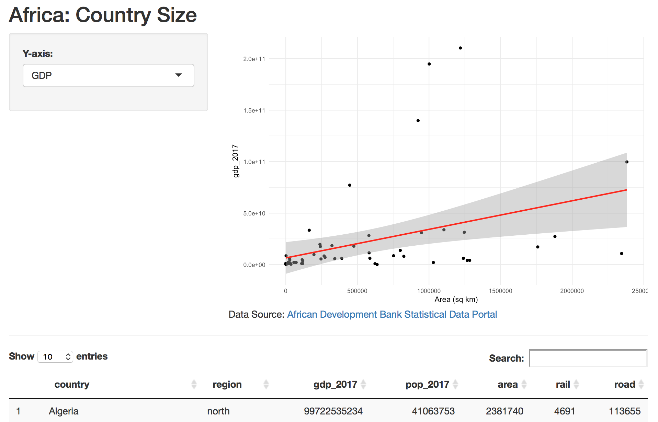

Slide 103
Notes:
Add static content to the UI
Named for, and translated into, HTML tags

Slide 104
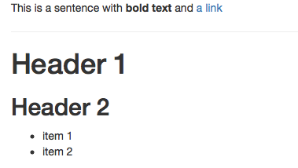
Tag Examples
ui <- fluidPage(
p("This is a sentence with", strong("bold text"),
"and", a("a link", href="http://www.google.com")
),
hr(),
h1("Header 1"),
h2("Header 2"),
tags$ul(tags$li("item 1"),
tags$li("item 2"))
)
Notes:
some with tags$ others without
nesting

Slide 105
ui <- fluidPage(
titlePanel("Old Faithful Geyser Data"),
h3(em("Built-in Data")),
sidebarLayout(
sidebarPanel(
sliderInput("bins", "Number of bins:",
min = 1, max = 50, value = 30)
),
mainPanel(
plotOutput("distPlot"),
tags$caption("Here is my plot caption")
)
)
)

Slide 106
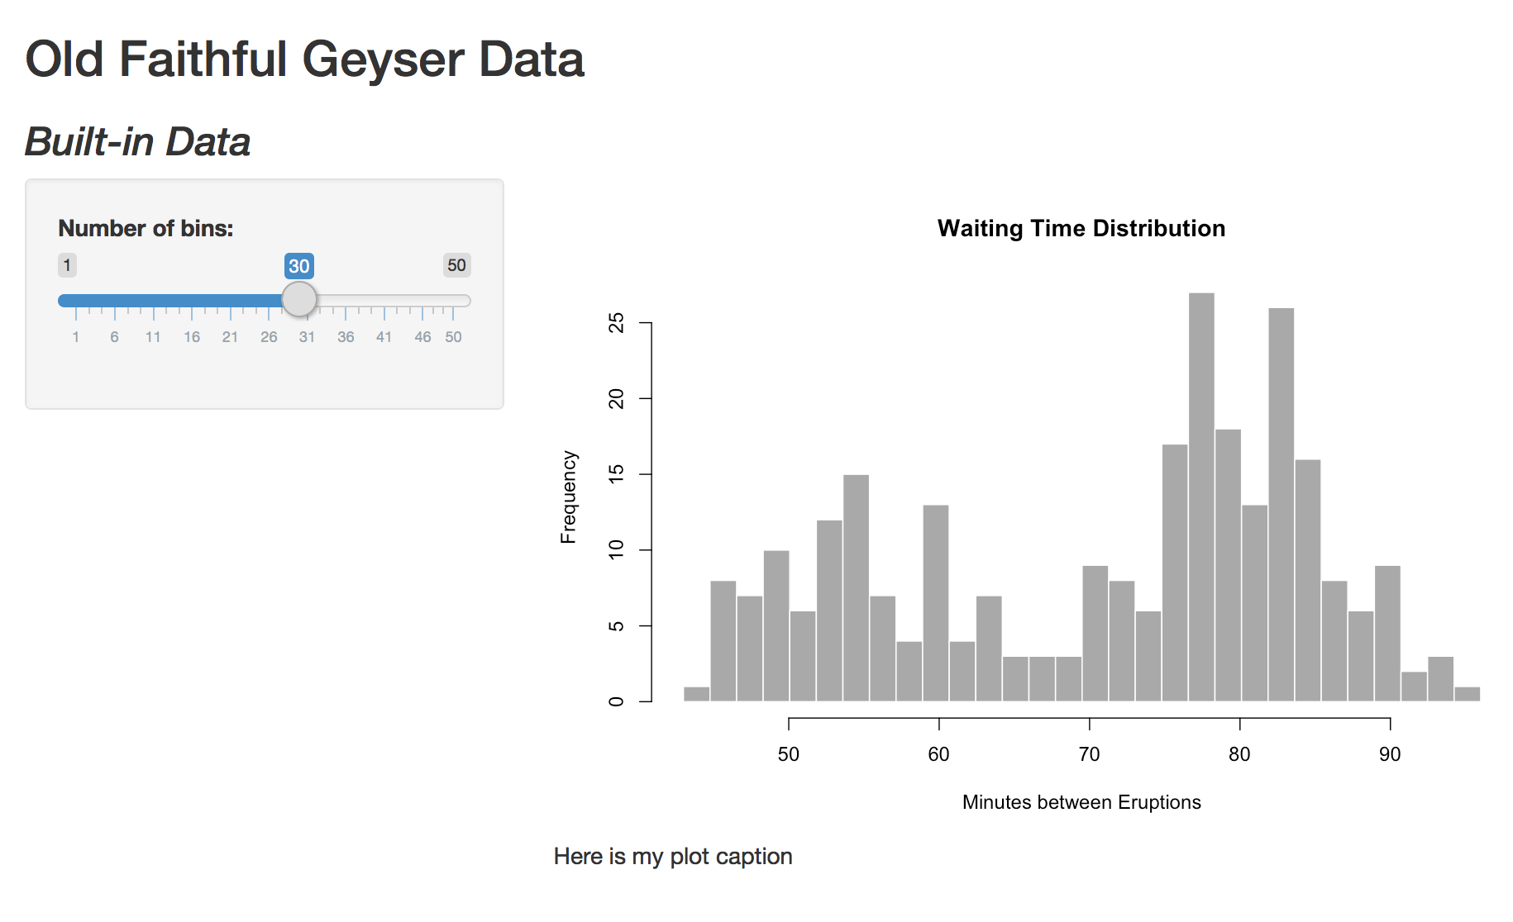

Slide 107
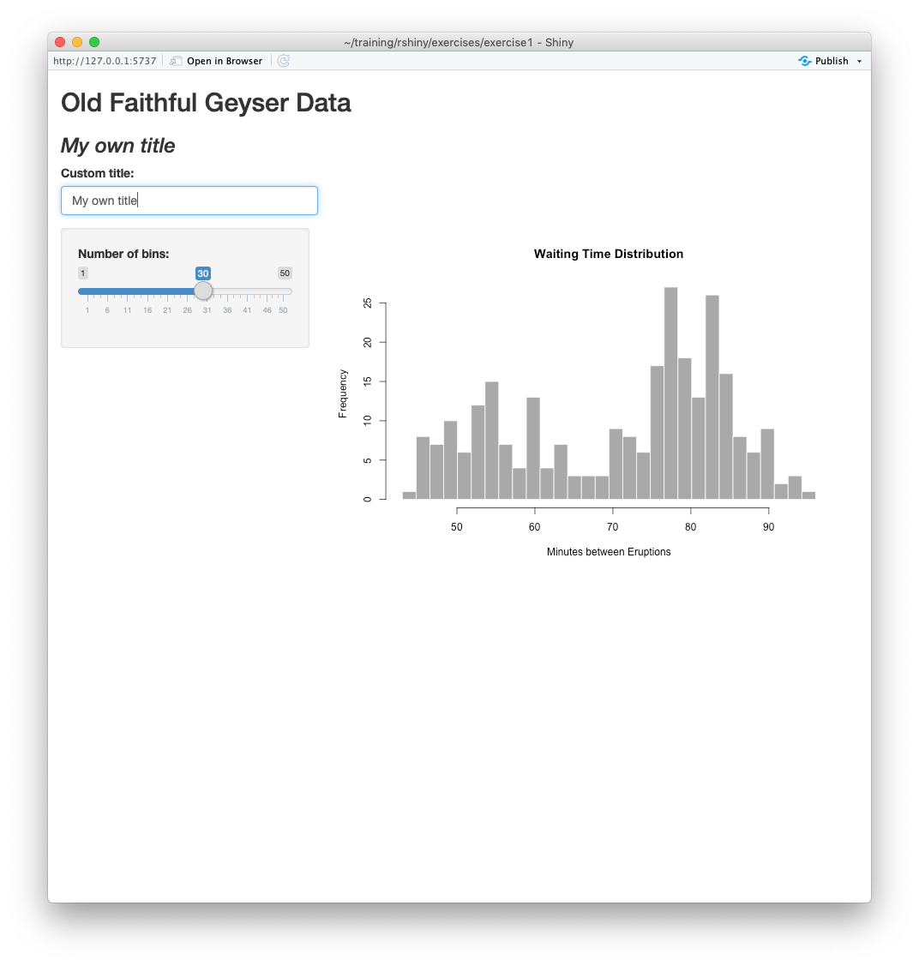

Slide 108
ui <- fluidPage(
titlePanel("Old Faithful Geyser Data"),
h3(em(textOutput("titleblock", label="Custom title:"))),
textInput("customtitle"),
...
)
server <- function(input, output) {
output$titleblock <- renderText({
input$customtitle
})
}

Slide 109
ui <- fluidPage(
titlePanel("Old Faithful Geyser Data"),
h3(em(textOutput("titleblock", label="Custom title:"))),
textInput("customtitle"),
...
)
server <- function(input, output) {
output$titleblock <- renderText({
input$customtitle
})
}

Slide 111
Exercise 2E

Slide 112

Exercise 2E
Work from exercises/exercise2/app.R or answer2c.R
Add a horizontal rule hr() between the mainPanel and verticalLayout.
Using tags$caption and an a tag for a link, add the source of the data under the plot inside the mainPanel:
African Development Bank Statistical Data Portal
http://dataportal.opendataforafrica.org

Slide 113
mainPanel(
plotOutput("plot1", brush="plot1_brush"),
tags$caption("Data Source: ",
a("African Development Bank Statistical Data Portal",
href="http://dataportal.opendataforafrica.org"))
)
), # ends sidebar layout
hr(),
verticalLayout(DT::dataTableOutput("datatable1"))

Slide 114
Layouts with Multiple Views

Slide 115
Navigation: tabsetPanel
https://shiny.rstudio.com/gallery/tabsets.html

Slide 116
mainPanel(
tabsetPanel(type = "tabs",
tabPanel("Plot", plotOutput("plot")),
tabPanel("Summary", verbatimTextOutput("summary")),
tabPanel("Table", tableOutput("table"))
)
)

Slide 117
Navigation: navlistPanel
https://shiny.rstudio.com/gallery/navlistpanel-example.html

Slide 118
Navigation: navbarPage
https://shiny.rstudio.com/gallery/navbar-example.html

Slide 120
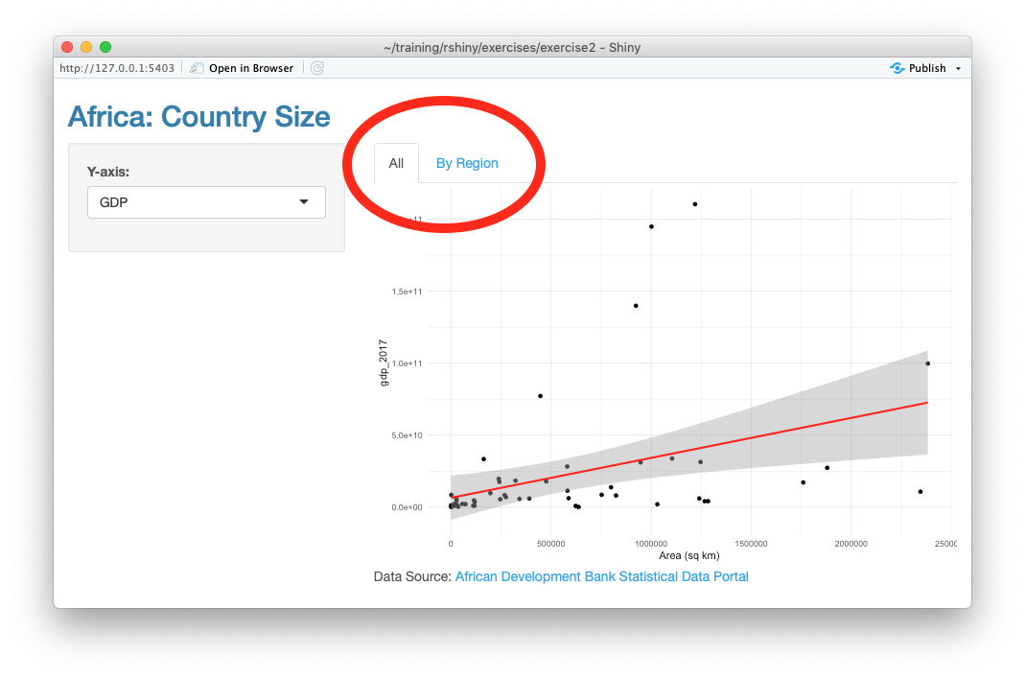
Exercise 2F

Slide 121

Exercise 2F
exercises/exercise2/exercise2f.R
Put a tabsetPanel inside the mainPanel with 2 tabs:
“All” tabPanel containing the existing plotOutput()
“By Region” tabPanel containing a new plotOutput with outputId="regionplot"
There is already code in the server section to render output$regionplot
Refer to documentation as needed.
Notes:
Go to the Shiny documentation: https://shiny.rstudio.com
Find the Reference Page for tabsetPanel.

Slide 122
mainPanel(
tabsetPanel(
tabPanel("All", plotOutput("plot1")),
tabPanel("By Region", plotOutput("regionplot"))
),
tags$caption("Data Source: ",
a("African Development Bank Statistical Data Portal",
href="http://dataportal.opendataforafrica.org"))
)

Slide 123
Shiny Themes
https://rstudio.github.io/shinythemes/

Slide 124

Exercise 2G
exercises/exercise2/ — any working app
Go to the Shiny themes page:
https://rstudio.github.io/shinythemes/
Find a Shiny theme you like.
Or, try the shinythemes::themeSelector()
Apply it to the app.

Slide 125
Custom Themes!
https://shiny.rstudio.com/articles/themes.html

Slide 126
Structure of Shiny Applications
UI: Layout, Inputs and Outputs
Server
Bringing it Together
Design Elements
Interactive Graphics
Sharing Your Shiny Application

Slide 127
Selecting Plot Points
plotOutput(outputId, width = "100%", height = "400px", click = NULL,
dblclick = NULL, hover = NULL, hoverDelay = NULL,
hoverDelayType = NULL, brush = NULL, clickId = NULL, hoverId = NULL,
inline = FALSE)
click
dblclick
hover
brush

Slide 128
Demo
examples/104-plot-interaction-select

Slide 129
click
plotOutput(outputId = "plot1",
click = "plot1_click"
)
input$plot1_click
input$plot1_click$x
input$plot1_click$y

Slide 130
Click Helper Function
nearPoints(dataframe_name,
input$plot1_click,
xvar = "x_variable_name",
yvar = "y_variable_name")
Subset of the data frame (or NULL)
Notes:
Subset could be empty. Get NULL there's no click
use this in the server portion of the code

Slide 131
Click Helper Function
nearPoints(dataframe_name,
input$plot1_click,
xvar = "x_variable_name",
yvar = "y_variable_name")
dataframe_name[,"x_variable_name"]
example: mtcars[,"wt"]
Notes:
Subset could be empty. Get NULL there's no click
use this in the server portion of the code

Slide 132
Click Helper Function
nearPoints(dataframe_name,
input$plot1_click,
xvar = "x_variable_name",
yvar = input$selectedvar)
dataframe_name[,input$selectedvar]
Notes:
Subset could be empty. Get NULL there's no click
use this in the server portion of the code

Slide 133
brush
plotOutput(outputId = "plot1",
brush = "plot1_brush"
)
input$plot1_brush
input$plot1_brush$xmin
input$plot1_brush$xmax
input$plot1_brush$ymin
input$plot1_brush$ymax

Slide 134
Brush Helper Function
brushedPoints(dataframe_name,
input$plot1_brush,
xvar = "x_variable_name",
yvar = "y_variable_name")
Subset of the data frame (or NULL)
Notes:
Quoted variable name, or, if you were using another variable here, it wouldn't be in quotes
Again, use it in the server part of the code

Slide 135
Demo Code

Slide 136

Exercise 2C
exercises/exercise2/app.R or answer2b.R
Set the brush argument to plotOutput to "plot1_brush"
Change DT::renderDataTable() to use output from brushedPoints() instead of using africadata directly
Notes:
Going back to the example we used before for debugging — application with data on African countries.

Slide 137
mainPanel(
plotOutput("plot1", brush="plot1_brush")
)
output$datatable1 <- DT::renderDataTable(
brushedPoints(africadata, input$plot1_brush,
xvar="area", yvar=input$yval)
)

Slide 138
Structure of Shiny Applications
UI: Layout, Inputs and Outputs
Server
Bringing it Together
Design Elements
Interactive Graphics
Sharing Your Shiny Application

Slide 139
Sharing Your Application
Share your Files
Other R Users can run your app locally
Deploy to a Server
shinyapps.io or a custom server

Slide 140
http://shinyapps.io
Make an Account or Sign In

Slide 141
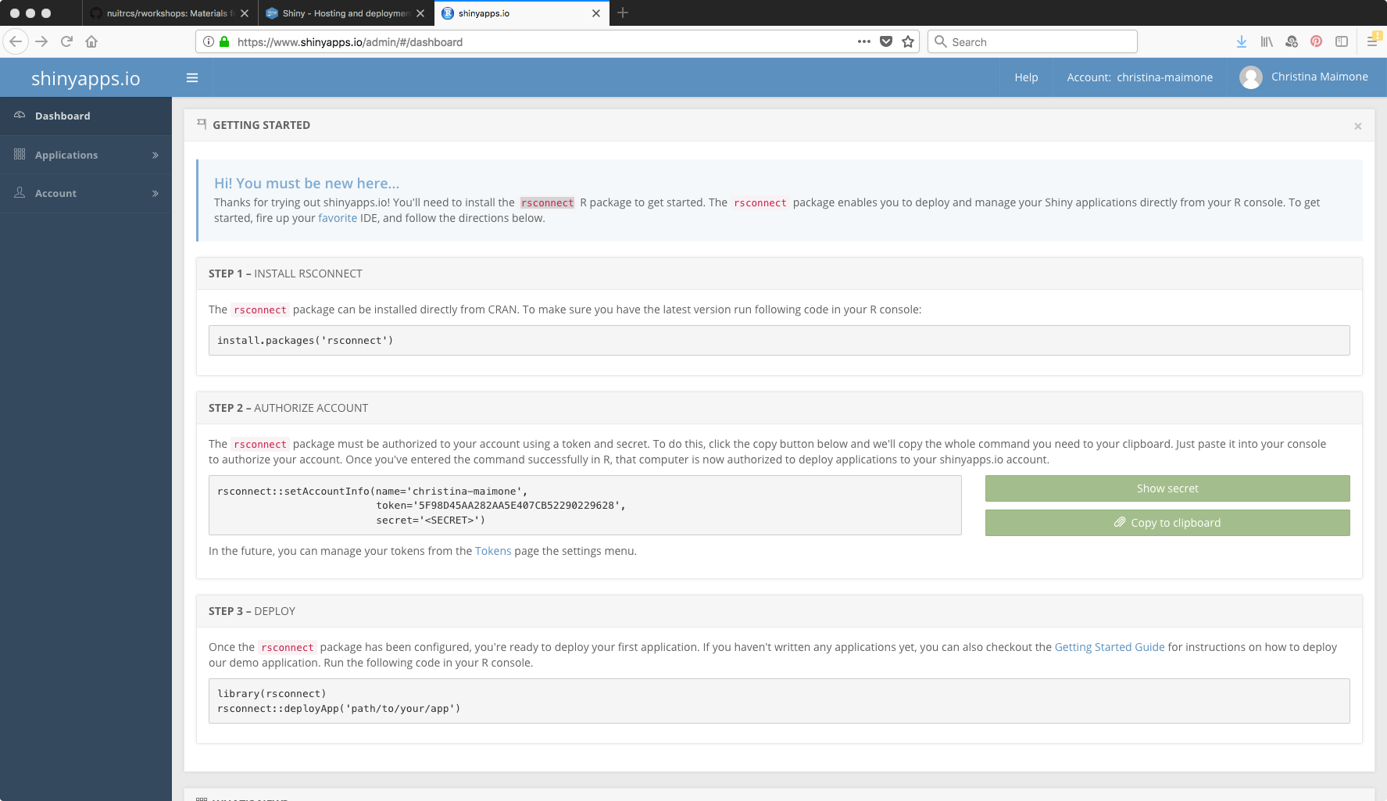
Install rsconnect if you haven't
Copy and Run in Console

Slide 142
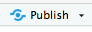
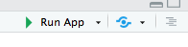
shinyapps.io
rsconnect::deployApp('exercises/exercise3')

Slide 143
How Do I Get Started?
Use the Shiny website:
Lots of well-written documentation and articles
Explore the gallery:
Find an app, get the code, and modify it

Slide 144

That's It
Questions?
Christina Maimone
christina.maimone@northwestern.edu
@maimonecr

Slide 146
Extras

Slide 147
Verifying and Validating

Slide 148
Verifying Input
The req() function specifies requirements for the code that follows to work.
Arguments are the values that should exist or conditional tests.
It stops execution of the expression (code block) if the conditions aren't met.

Slide 149
Verifying Input
output$letters <- renderText({
req(input$n)
paste(rep('*', input$n), collapse=' ')
})

Slide 150
Verifying Input
output$letters <- renderText({
req(input$n > 0 & input$n <= 30)
paste(rep('*', input$n), collapse=' ')
})

Slide 151
Verifying Input
The validate() function checks if certain conditions are true, and returns error messages if not.
Can take multiple conditions.
Specify each condition with
need(test, message)

Slide 152
Verifying Input
output$letters <- renderText({
validate(need(input$n,
"Please enter a number"))
paste(rep('*', input$n), collapse=' ')
})

Slide 153
Verifying Input
output$letters <- renderText({
validate(need(input$n > 0 & input$n <= 30,
"Please enter a number between 1 and 30"))
paste(rep('*', input$n), collapse=' ')
})

Slide 154

Challenge Exercise 2D
exercises/exercise2/app.R or answer2c.R
Fix the application so that the DataTable doesn't display empty rows for missing data.
Subset the data returned by brushedPoints() to filter out rows with missing values in the input$yval column
Use req() to check that there's at least one row in the subset
Make sure the last line in the {} is the data to display
BONUS
If nothing is highlighted on the plot, show all of the data in the DataTable.

Slide 155
output$datatable1 <- DT::renderDataTable({
req(input$plot1_brush)
pts <- brushedPoints(data, input$plot1_brush,
xvar="area",
yvar=input$yval)
pts <- subset(pts, !is.na(pts[input$yval]))
req(nrow(pts) > 0)
pts
})

Slide 156
output$datatable1 <- DT::renderDataTable({
if(is.null(input$plot1_brush)) {
data
} else {
req(input$plot1_brush)
pts <- brushedPoints(data,
input$plot1_brush, xvar="area",
yvar=input$yval)
pts <- subset(pts, !is.na(pts[input$yval]))
req(nrow(pts) > 0)
pts
}
})

Slide 157
Reactivity
How does this all work?

Slide 158
Notes:
How does the input value actually get to the output? In R, if you change one value, it doesn't automatically update expressions using that value. So what's going on here?
We're going to walk through the process to better understand what's going on with Shiny for two reasons: 1) it will help you understand what's going on behind the scenes, which is useful for knowing what's possible and for debugging, 2) to get introduced to some of the terminology used in case you want to do more advanced things with Shiny later.

Slide 159
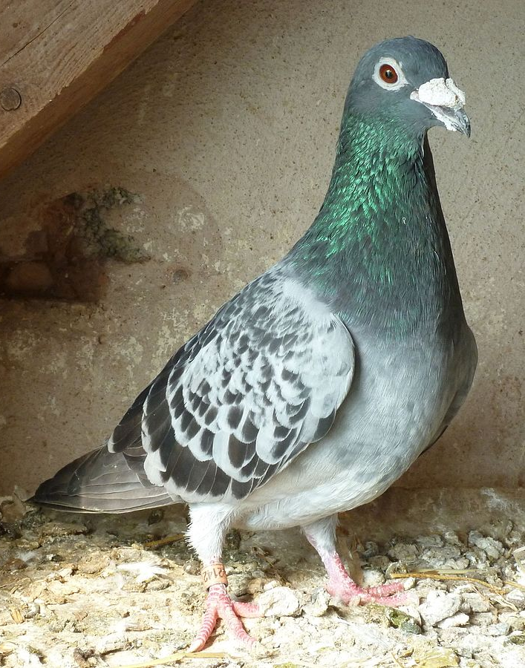
Shiny Server
output$distplot
I see you're 30.
I need to know when you
change. Send this
pigeon.
input$bins
output$distplot
30
https://shiny.rstudio.com/articles/understanding-reactivity.html
Photo: By Freitag, Jens - Own work, CC BY-SA 3.0, https://commons.wikimedia.org/w/index.php?curid=47529895
Notes:
pigeon=callback
So what happens when your application is created? How do we go from the code to a functioning application?

Slide 160
Shiny Server
output$distplot
output$distplot
Something you need changed
input$bins
output$distplot
30
25
https://shiny.rstudio.com/articles/understanding-reactivity.html
Photo: By Freitag, Jens - Own work, CC BY-SA 3.0, https://commons.wikimedia.org/w/index.php?curid=47529895

Slide 161
Reactive Sources and Endpoints
input$_____
Reactive Source
Sends signals
output$_____
Reactive Endpoint
1. Told to re-execute
2. Request values from sources
Notes:
general terms

Slide 162
Reactive Sources and Endpoints
input$_____
Reactive Value
output$_____
Observer
Notes:
Implementation

Slide 163
Reactive Sources and Endpoints
input
reactiveValues
input$_____
reactiveVal
Notes:
actual object types

Slide 164
Reactivity: Next Steps
More complicated relationships
Reactive expressions
Interruptions to normal reactive flow
Triggering events explicitly

Slide 165

Exercise 3A & B
exercises/exercise3/app.R
Instructions in the file
A: Run 2 sessions of the application. Examine the behavior.
Laptop users: Copy the URL from upper left and open two web browser tabs or windows with this URL.
Cloud users: Find a partner who is running from their laptop.
B: Make some updates to validate inputs and change behavior
Notes:
We'll come back to our Africa application, but we're going to take a look at this reactivity first.
Numbers in the URL may be different for you than what's in this picture.

Slide 166



